Slide 1
Computer Networks
15CS52
Venugopala Rao A S
Assistant Professor(Senior)
Dept of CSE, SMVITM Bantakal

Slide 2

TRANSPORT LAYER
With a packet size, L, of 1,000 bytes (8,000 bits) per packet, including both header fields and data, the time needed to actually transmit the packet into the 1 Gbps link is
if the sender begins sending the packet at t=0, then at t = L/R = 8 microseconds, the last bit enters the channel at the sender side.
The packet then makes its 15-msec propagation, with the last bit of the packet emerging at the receiver at t = RTT/2 + L/R =15.008 msec.
Assuming that ACK packets are extremely small (so that we can ignore their transmission time) and that the receiver can send an ACK as soon as the last bit of a data packet is received, the ACK emerges back at the sender at t = RTT + L/R = 30.008 msec.
Venugopala Rao A S, SMVITM

Slide 3

TRANSPORT LAYER
At this point, the sender can now transmit the next message.
Thus, in 30.008 msec, the sending time was only 0.008 msec.
If we define the utilization of the sender (or the channel) as the fraction of time the sender is actually busy sending bits into the channel, we get,
This means Utilization is only for 0.0027%
This means the sender was able to send only 1,000 bytes in 30.008 milliseconds, an effective throughput of only 267 kbps—even though a 1 Gbps link was available!
This example shows how network protocols can limit the capabilities provided by the underlying network hardware
Venugopala Rao A S, SMVITM

Slide 4

TRANSPORT LAYER
How to solve this performance problem?
Root cause of problem is working in a stop-and-wait manner,
We may allow the sender to send multiple packets without waiting for acknowledgments, as illustrated below
Figure shows that if the sender is allowed to transmit three packets before having to wait for acknowledgments, the utilization is tripled.
Since the many in-transit sender-to-receiver packets can be visualized as filling a pipeline, this technique is known as pipelining.
Venugopala Rao A S, SMVITM

Slide 5
TRANSPORT LAYER
Pipelining has the following consequences for reliable data transfer protocols
The range of sequence numbers must be increased
  since each in-transit packet must have a unique sequence number and there may be multiple, in-transit, unacknowledged packets.
The sender and receiver sides of the protocols may have to buffer more than one packet.
  At minimum, the sender will have to buffer packets that have been transmitted but not yet acknowledged.
  Buffering of correctly received packets may also be needed at the receiver.
The range of sequence numbers and the buffering requirements depend on how data transfer protocol responds to lost, corrupted, and overly delayed packets.
  Two well known approaches - Go-Back-N and selective repeat
Venugopala Rao A S, SMVITM

Slide 6
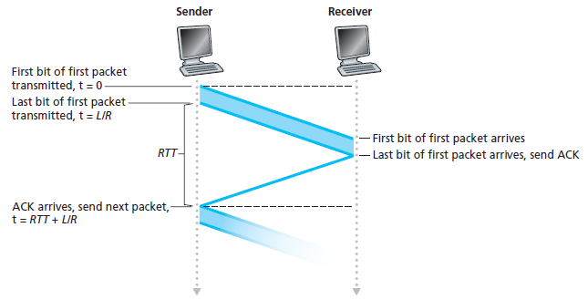
TRANSPORT LAYER
Go-Back-N (GBN)
In this protocol, the sender is allowed to transmit multiple packets (when available) without waiting for acknowledgment
But is constrained to have maximum of unacknowledged packets in the pipeline not more than N, maximum allowable number.
Comparing stop-and-wait with pipelined stop-and-wait
Venugopala Rao A S, SMVITM

Slide 7
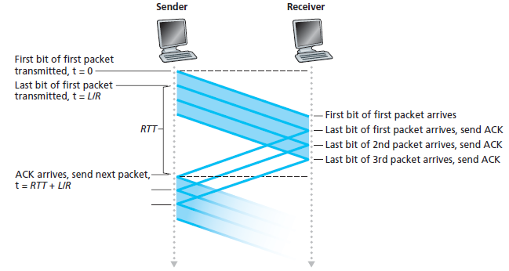
TRANSPORT LAYER
Venugopala Rao A S, SMVITM

Slide 8
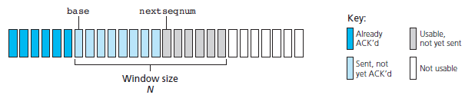
TRANSPORT LAYER
Sequence numbers:
Figure below shows the sender’s view of the range of sequence numbers in a GBN protocol.
Base - the sequence number of the oldest unacknowledged packet
Nextseqnum - the smallest unused sequence number (that is, the sequence number of the next packet to be sent),
We can identify four intervals in the range of sequence numbers.
Venugopala Rao A S, SMVITM

Slide 9
TRANSPORT LAYER
Sequence numbers in the interval [0,base-1] correspond to packets that have already been transmitted and acknowledged.
The interval [base,nextseqnum-1] corresponds to packets that have been sent but not yet acknowledged.
Sequence numbers in the interval [nextseqnum,base+N-1] can be used for packets that can be sent immediately, once data arrives from the upper layer.
Sequence numbers greater than or equal to base+N cannot be used until an unacknowledged packet currently in the pipeline (starting from sequence number base) has been acknowledged.
Venugopala Rao A S, SMVITM

Slide 10
TRANSPORT LAYER
The range of permissible sequence numbers for transmitted but not yet acknowledged packets can be viewed as a window of size N
As the protocol operates, this window slides forward over the sequence number space.
Hence N is referred as the window size and the GBN protocol is known as a sliding-window protocol.
Point to be asked..
  Why we would limit the number of outstanding, unacknowledged packets to a value of N in the first place?
  Why not allow an unlimited number of such packets?
Flow control is main reason to impose a limit on the sender.
Venugopala Rao A S, SMVITM

Slide 11
TRANSPORT LAYER
In practice, a packet’s sequence number is carried in a fixed-length field in the packet header.
If k is the number of bits in the packet sequence number field, the range of sequence numbers is thus [0,2^{k} -1].
With a finite range of sequence numbers, all arithmetic involving sequence numbers must then be done using modulo 2k arithmetic.
The sequence number space can be thought of as a ring of size 2k, where sequence number 2^{k}– 1 is immediately followed by sequence number 0.)
In rdt3.0 we had a 1-bit sequence number and a range of sequence numbers of [0,1].
Venugopala Rao A S, SMVITM

